Slide 1

Marginalizing over baryonic effects
Francisco Villaescusa-Navarro
In Collaboration with:
Ana M. Delgado, Daniel Angles-Alcazar, Shy Genel, Shirley Ho & David Spergel
Cosmological Simulations SWG meeting Barcelona

Slide 2
Information content
Problem:
Lots of information on small scales
Information beyond power spectrum
What about baryonic effects?

Slide 3
Baryonic effects
Huge dynamical range; subgrid physics
Different implementations & hydrodynamic solvers
We are producing realistic galaxies
Do we believe it?
Our conservative approach: marginalize over them

Slide 4
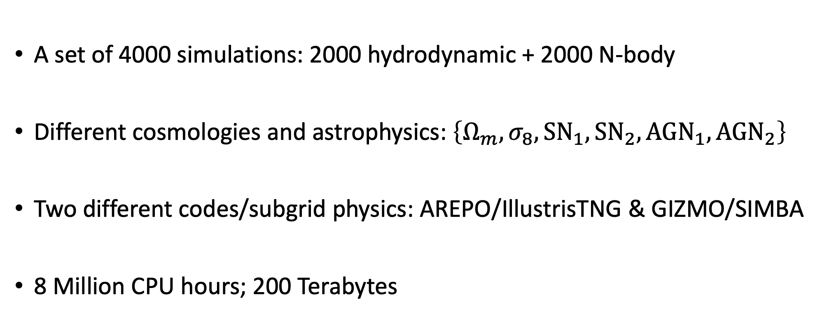
The CAMEL Simulations
(Cosmology and Astrophysics with MachinE Learning)
A set of 4000 simulations: 2000 hydrodynamic + 2000 N-body
Different cosmologies and astrophysics: $\left\{Ω_{m},σ_{8},SN_{1},SN_{2},AGN_{1},AGN_{2}\right\}$
Two different codes/subgrid physics: AREPO/IllustrisTNG & GIZMO/SIMBA
8 Million CPU hours; 200 Terabytes

Slide 5
The CAMEL
simulations
Gas column density
at z=5

Slide 6
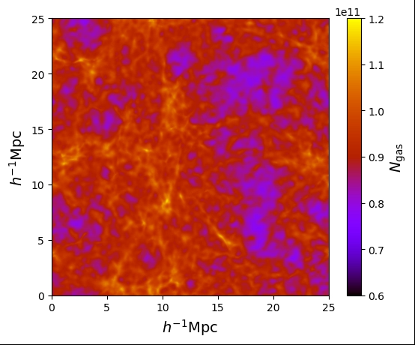
The CAMEL
simulations
Gas column density
at z=5

Slide 7
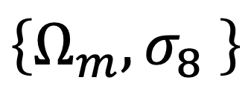
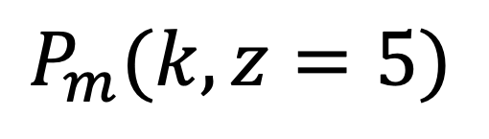
The CAMEL Simulations: baryonic effects
Random Forest Regressor
$$P_{m}(k,z=5)$$
$$\left\{Ω_{m},σ_{8} \right\}$$
(SIMBA hydro sims)

Slide 8
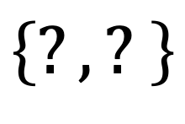
The CAMEL Simulations: baryonic effects
Random Forest Regressor
$$P_{m}(k,z=5)$$
$$\left\{?,? \right\}$$
(SIMBA hydro sims)
(Trained on subset of SIMBA sims)

Slide 9
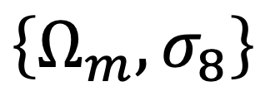
The CAMEL Simulations: baryonic effects
Random Forest Regressor
$$P_{m}(k,z=5)$$
$$\left\{Ω_{m},σ_{8}\right\}$$
(SIMBA hydro sims)

Slide 10
The CAMEL Simulations: baryonic effects
Random Forest Regressor
$$P_{m}(k,z=5)$$
$$\left\{?,? \right\}$$
(IllustrisTNG hydro sims)
(Trained on SIMBA sims)

Slide 11
The CAMEL Simulations: baryonic effects

Slide 12
The CAMEL Simulations: baryonic effects

Slide 13
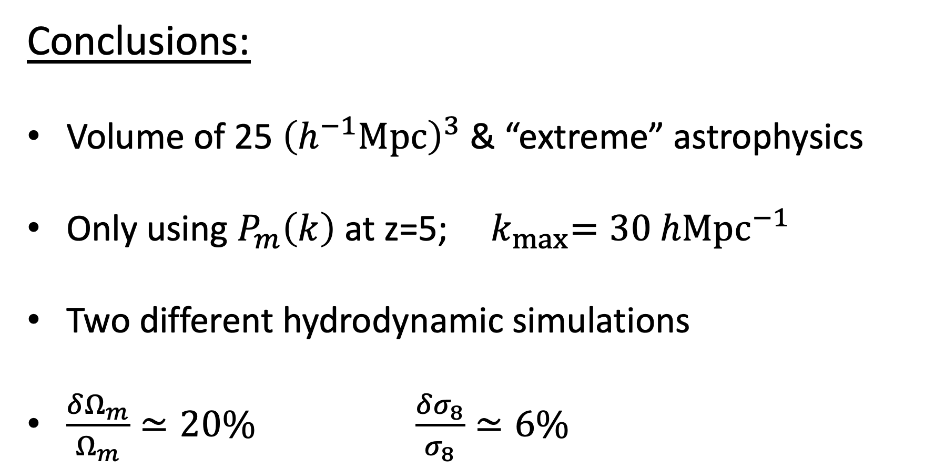
The CAMEL Simulations: baryonic effects
Conclusions:
Volume of 25 ${\left(h^{−1}Mpc\right)}^{3}$ & “extreme” astrophysics
Only using $P_{m}\left(k\right)$ at z=5; ${ k}_{max}=30 hMpc^{−1}$
Two different hydrodynamic simulations
$\frac{δΩ_{m}}{Ω_{m}}≃20\% \frac{δσ_{8}}{σ_{8}}≃6\%$

Slide 14
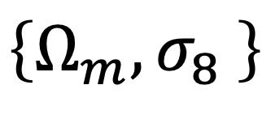
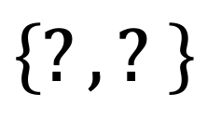
Next steps
$$\left\{Ω_{m},σ_{8} \right\}$$
Deep convolutional neural network
(SIMBA hydro sims)
$$\left\{?,? \right\}$$
(IllustrisTNG hydro sims)

